Slide 1


Random Forecast Model using Addidas Sales Data
This Photo by Unknown Author is licensed under CC BY-SA

Slide 2
OUTLINE
INTRODUCTION
ANALYSIS
BACKGROUND RESEARCH
METHODOLOGY
CONCLUSION

Slide 3
INTRODUCTION
BACKGROUND:
Adidas is one of the largest sports and fitness brands in the world
It has the second largest market share in the United States
As they are one of the giants in retail, their dataset is chosen
RELEVANCE:
Adidas sales dataset has been chosen for the project as it is a competitive brand
Adidas is currently the market leader in Europe and is close second to Nike in the United States
To better estimate the products to develop based on the sales.

Slide 4
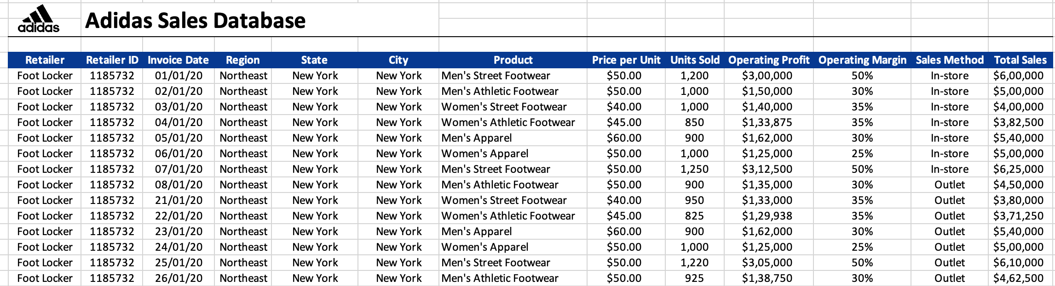
RESEARCH BACKGROUND
To create a random forest model based on selected dataset for Adidas and to perform an exploratory analysis using historical sales data in the United States.
Dataset includes important variables affecting the sales like region, retailer, product, number of units sold, and unit price.

Slide 5

SCOPE AND OBJECTIVE
SCOPE
To provide insights into the performance of Adidas products in different markets product categories
By considering variables that influence sales, such as pricing, units sold, operating profit and selected categorical variables.
OBJECTIVE
The objective of the data set is to understand the sales patterns of Adidas products, identify trends and patterns.
To develop machine learning algorithm.
Find best fit model for selected dataset (Random Forest vs SVM).

Slide 6
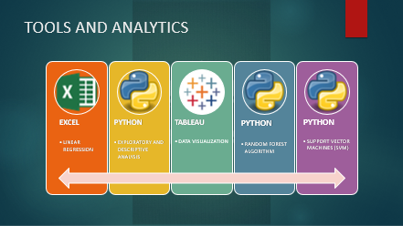
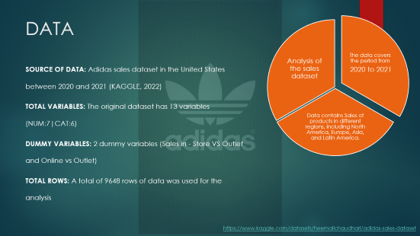
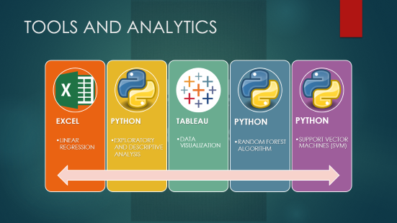
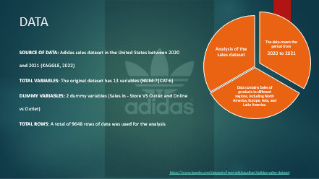
METHODOLOGY

Slide 7
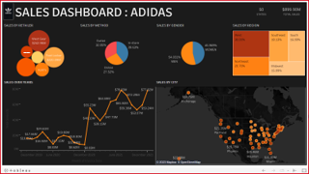
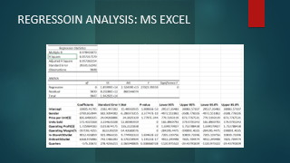
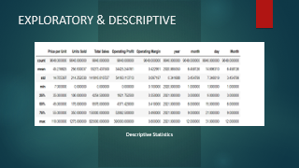
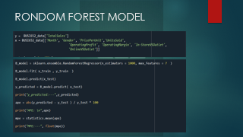
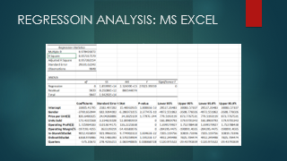
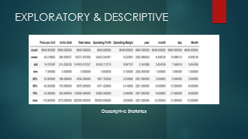

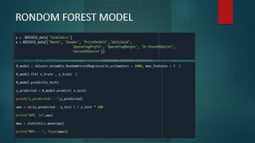
ANALYSIS

Slide 8
CONCLUSION
1. The average products price is $45.
2. The sales volume has an average of 256.93 units sold and standard deviation of 214.25.
3. The average total sales revenue was $93,273.44, with standard deviation of $141,916.02.
4. The average operating margin was 0.42, with a standard deviation of 0.10.
5. Sales numbers for retailers like WALMART and AMAZON are on lower side
RECOMMENDATION
Retailers should consider pricing strategies to remain competitive while maintaining profitability.
Retailers should analyze the factors that contribute to this variation and develop targeted marketing strategies to boost sales in underperforming regions.
Retailers should identify best practices from high-performing retailers and apply them to improve sales performance.
Retailers earn 42% as Profit from total revenue. Should aim to improve their operating margins by increasing sales volume and reducing costs.

Slide 9
REFERENCES
Chaudhari, H. (2022, December 23). Adidas Sales Dataset. Kaggle. Retrieved March 17, 2023, from https://www.kaggle.com/datasets/heemalichaudhari/adidas-sales-dataset
Joshi, R., Gupte, R., & Saravanan, P. (2018). A Random Forest Approach for Predicting Online Buying Behavior of Indian Customers. Theoretical Economics Letters, 08(03), 448–475. https://doi.org/10.4236/tel.2018.83032
Kelleher, J. D., Mac Namee, B., & D’Arcy, A. (2020). Fundamentals of Machine Learning for Predictive Data Analytics, second edition: Algorithms, Worked Examples, and Case Studies. MIT Press.
Laursen, G., & Thorlund, J. (2016). Business Analytics for Managers: Taking Business Intelligence Beyond Reporting. John Wiley & Sons.
Saraswathi, K., Renukadevi, N. T., Nandhinidevi, S., Gayathridevi, S., & Naveen, P. (2021). Sales prediction using machine learning approaches. AIP Conference Proceedings. https://doi.org/10.1063/5.0068655

Slide 10





THANK YOU

Slide 11
Data contains Sales of products in different regions, including North America, Europe, Asia, and Latin America.
Analysis of the sales dataset
The data covers the period from
2020 to 2021
DATA
SOURCE OF DATA: Adidas sales dataset in the United States between 2020 and 2021 (KAGGLE, 2022)
TOTAL VARIABLES: The original dataset has 13 variables (NUM:7|CAT:6)
DUMMY VARIABLES: 2 dummy variables (Sales in - Store VS Outlet and Online vs Outlet)
TOTAL ROWS: A total of 9648 rows of data was used for the analysis
https://www.kaggle.com/datasets/heemalichaudhari/adidas-sales-dataset

Slide 12
TOOLS AND ANALYTICS
EXCEL
LINEAR REGRESSION
PYTHON
EXPLORATORY AND DESCRIPTIVE ANALYSIS
PYTHON
PYTHON
SUPPORT VECTOR MACHINES (SVM)
TABLEAU
DATA VISUALIZATION
RANDOM FOREST ALGORITHM

Slide 13
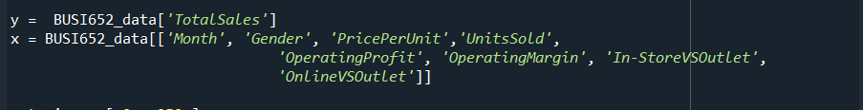
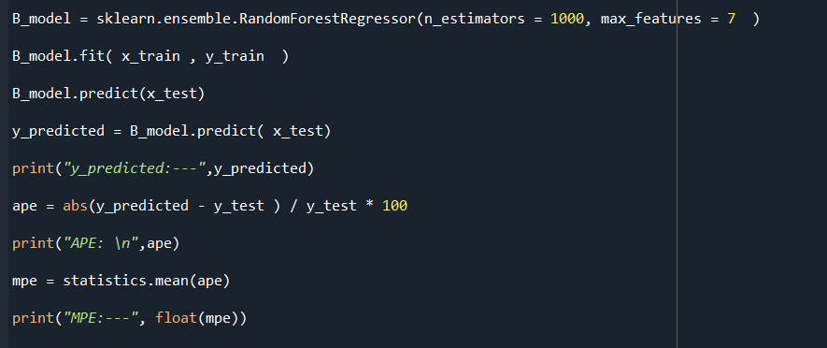
RONDOM FOREST MODEL

Slide 14
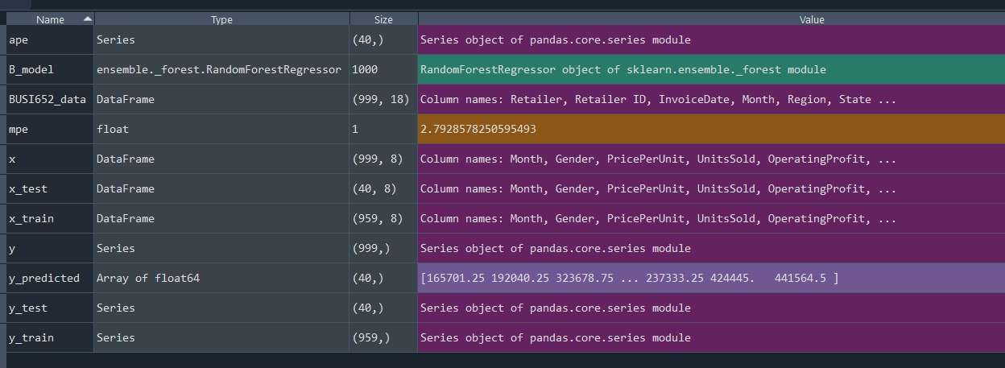
RONDOM FOREST MODEL

Slide 15
Summary of trials using different estimator values
Estimators | Values
n_estimators = 500 | 2.7651817627660122
n_estimators = 1000 | 2.7744050622798405
n_estimators = 1500 | 2.787803543625985
n_estimators = 2000 | 2.8811457728126535
n_estimators = 2500 | 2.872609580057337

Slide 16
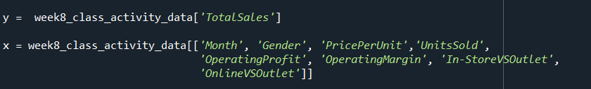
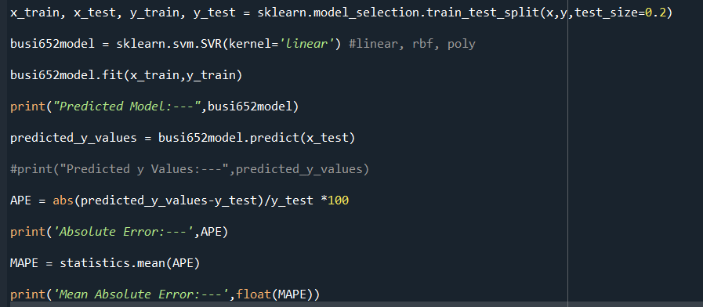
SVM MODEL

Slide 17
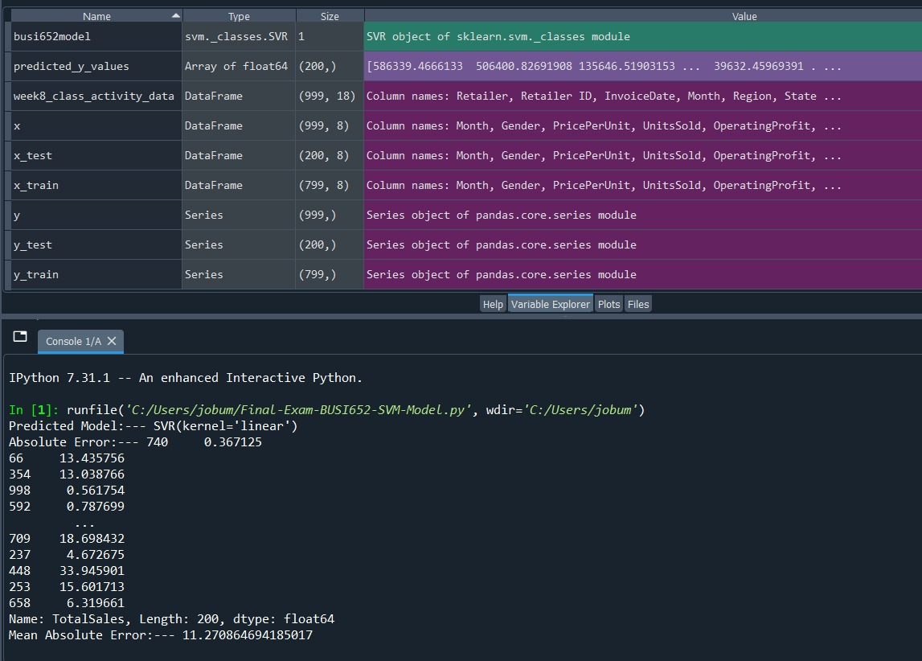
SVM MODEL

Slide 18
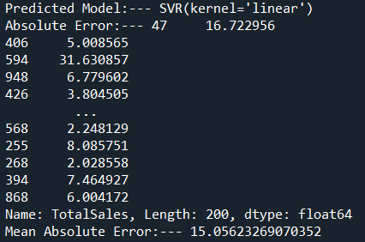
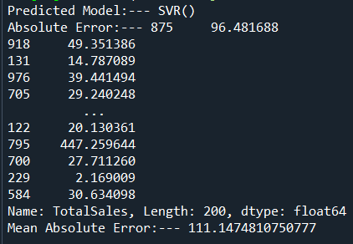
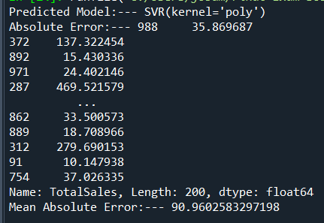
Summary of trials using different estimators
Kernel('linear’, ‘rbf’,’poly’) | Values
kernel='linear'
kernel=‘rbf'
kernel=‘poly' | 2.787803543625985

Slide 19

BEST MODEL
If we compare both models, we observed that Random Forest is best for Adidas sales data. The value of the Mean absolute error of the Random Forest is lower than SVM Mean absolute error.
All Mean Absolute Error values on different Estimators are 2.7 or 2.8 but in SVM it is 15.8 or higher.
This Photo by Unknown Author is licensed under CC BY

Slide 20
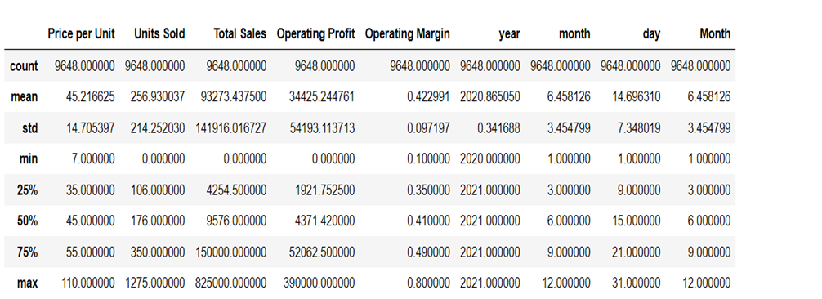
EXPLORATORY & DESCRIPTIVE
Descriptive Statistics

Slide 21
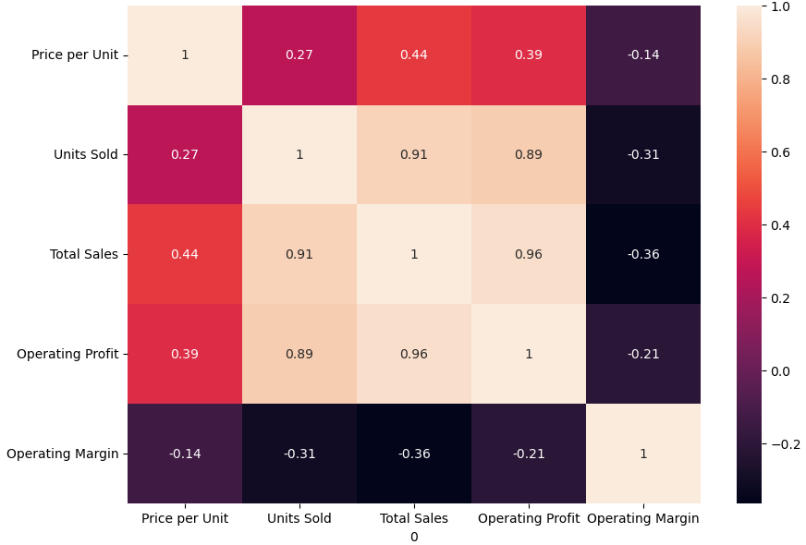
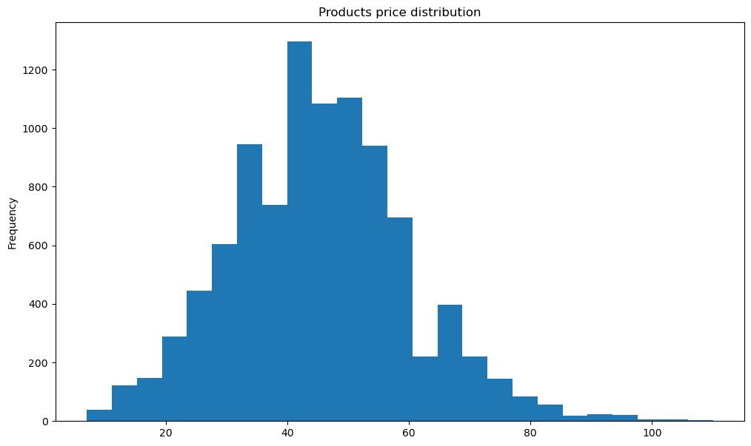
EXPLORATORY & DESCRIPTIVE
CORRELATION MATRIX
DISTRIBUTION OF PRICE PER UNIT

Slide 22
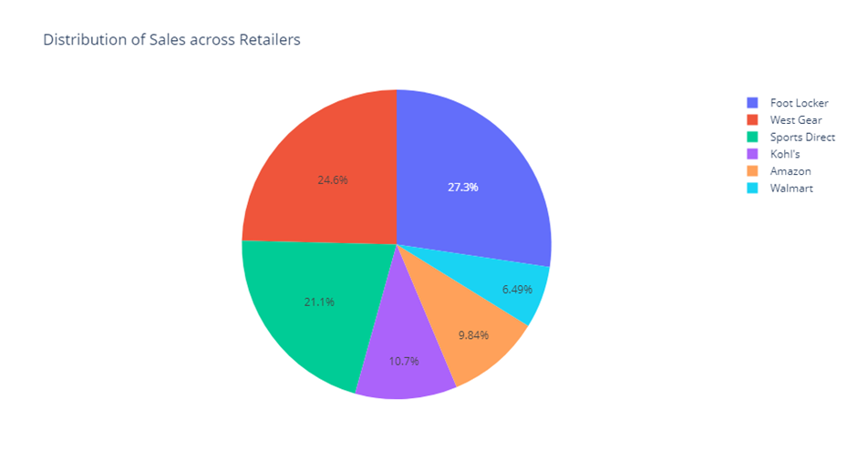
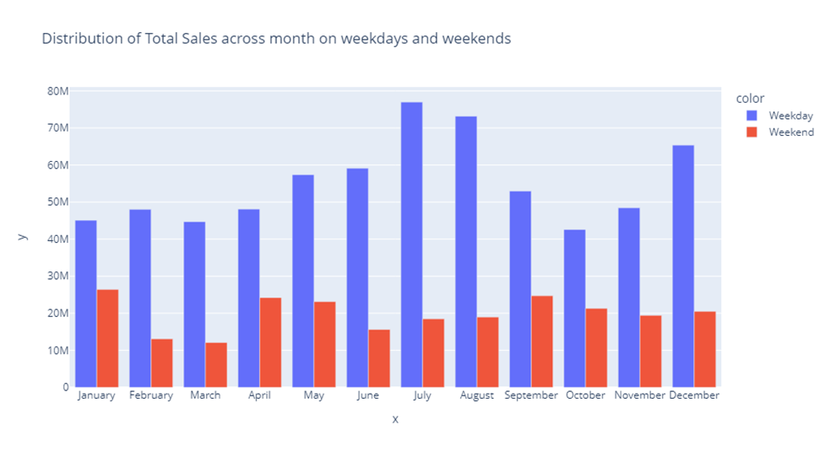
EXPLORATORY & DESCRIPTIVE
SALES ACROSS RETAILERS
WEEKDAYS vs WEEKENDS

Slide 23
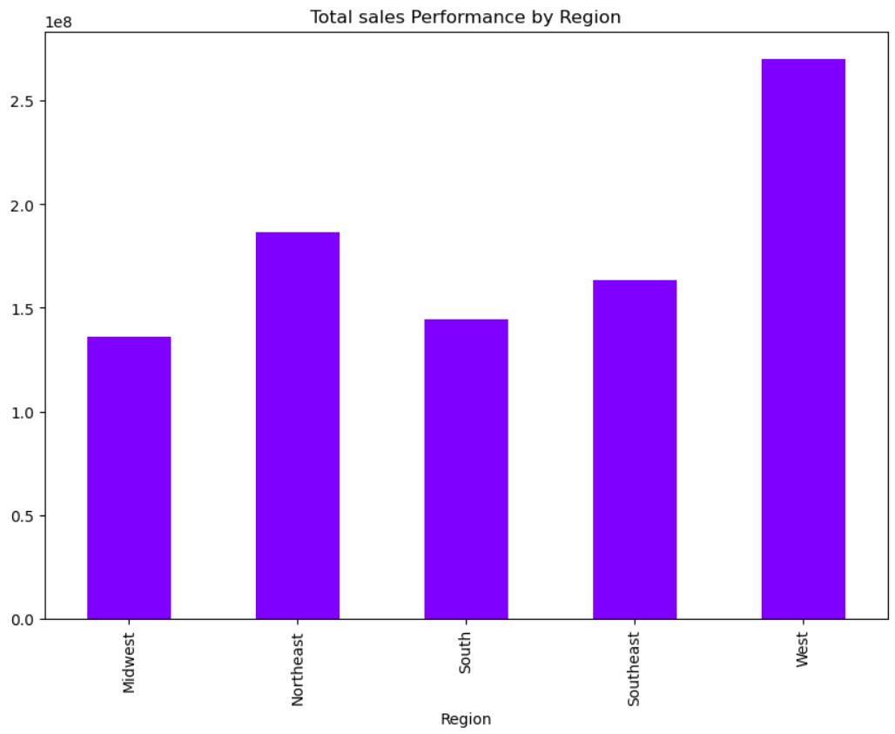
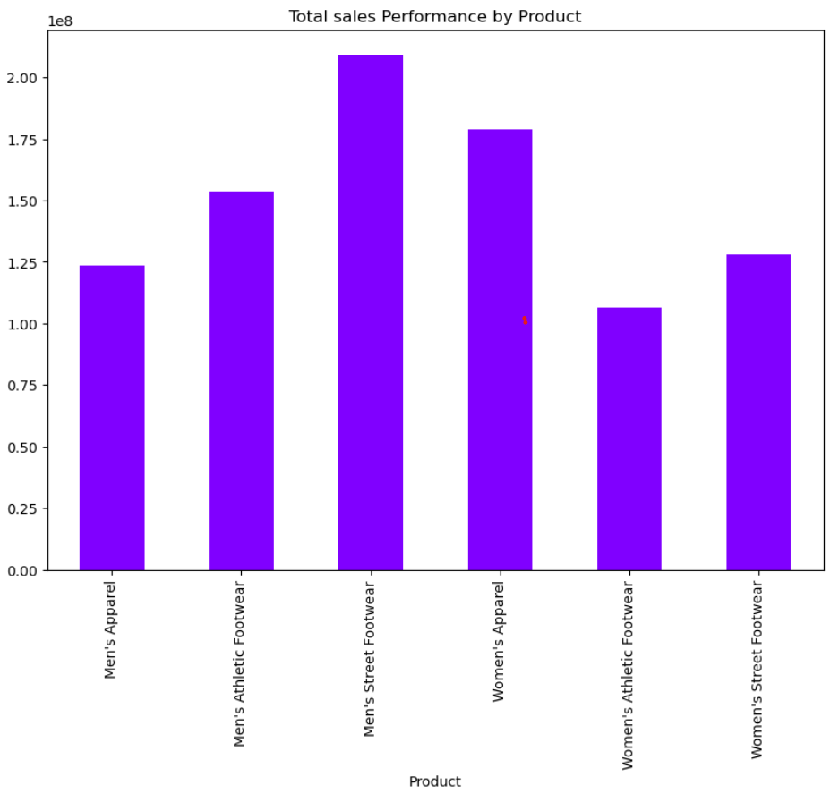
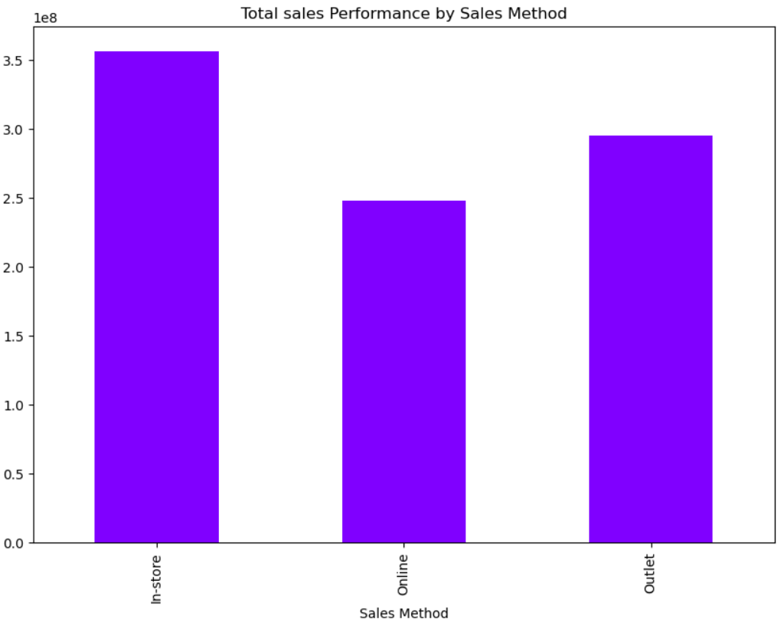
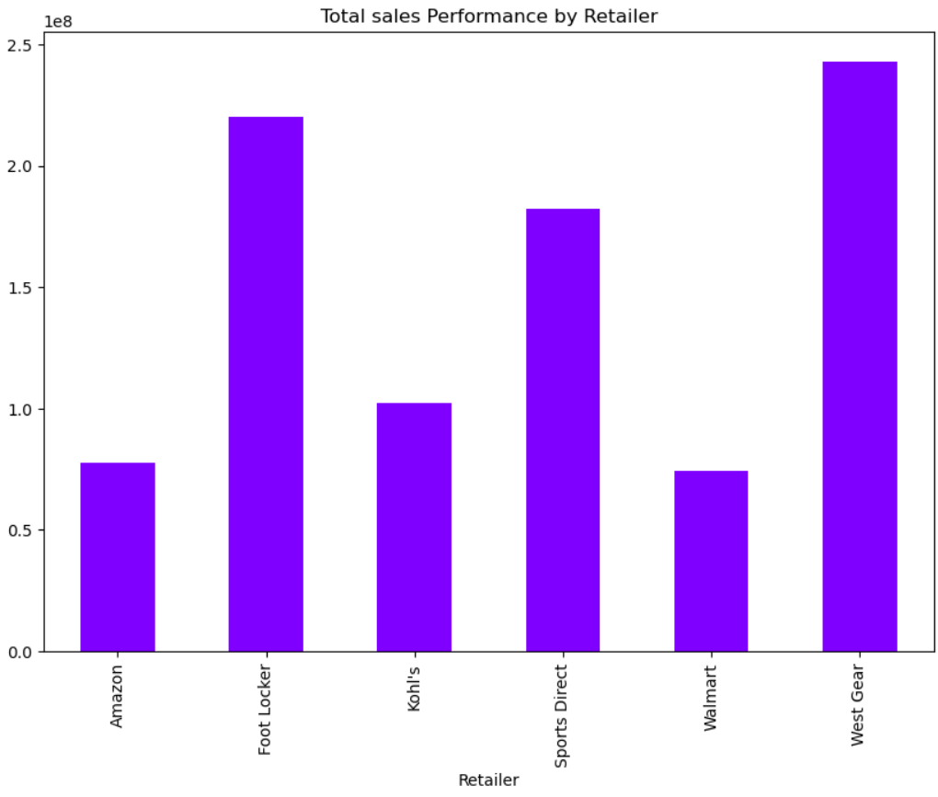

Slide 24

Walmart

Slide 25
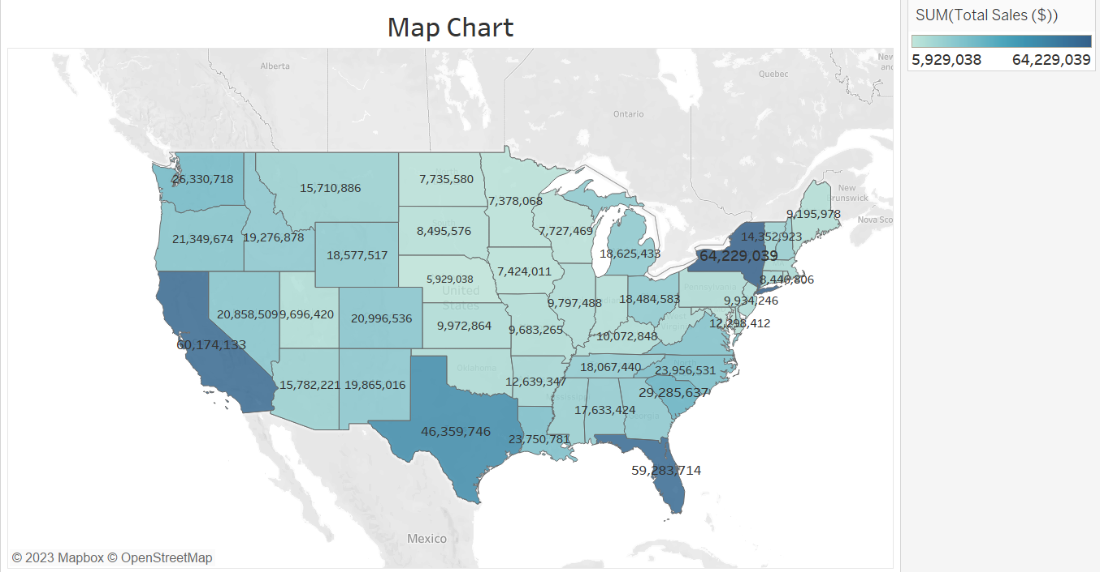

Slide 26
Walmart

Slide 27
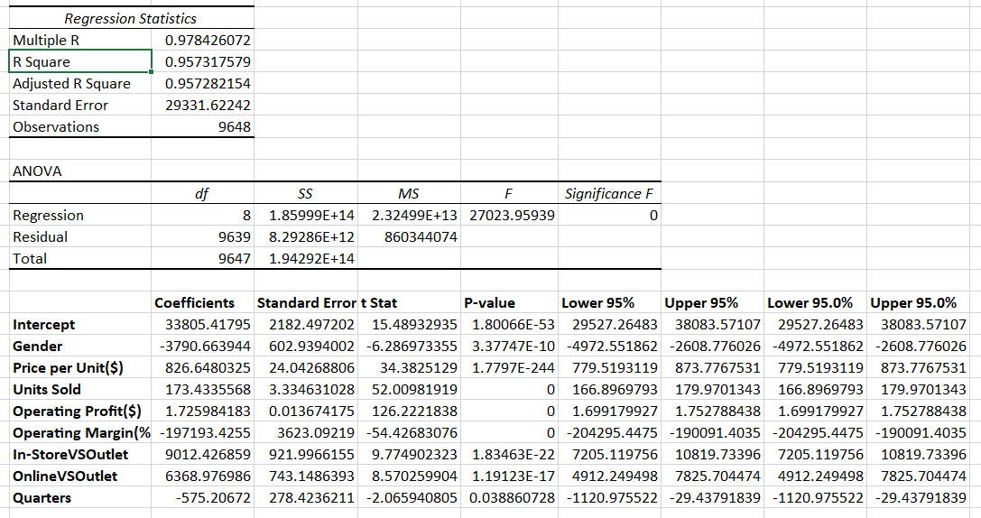
REGRESSOIN ANALYSIS: MS EXCEL

